Slide 1

Obesity and food education:
the urgency to promote healthy diets
Michele O. Carruba
Università degli Studi di Milano
Centro di Studio e Ricerca sull'Obesità (CSRO)
Dipartimento di Tecnologie Biomediche e Medicina Traslazionale

Slide 2


Slide 3
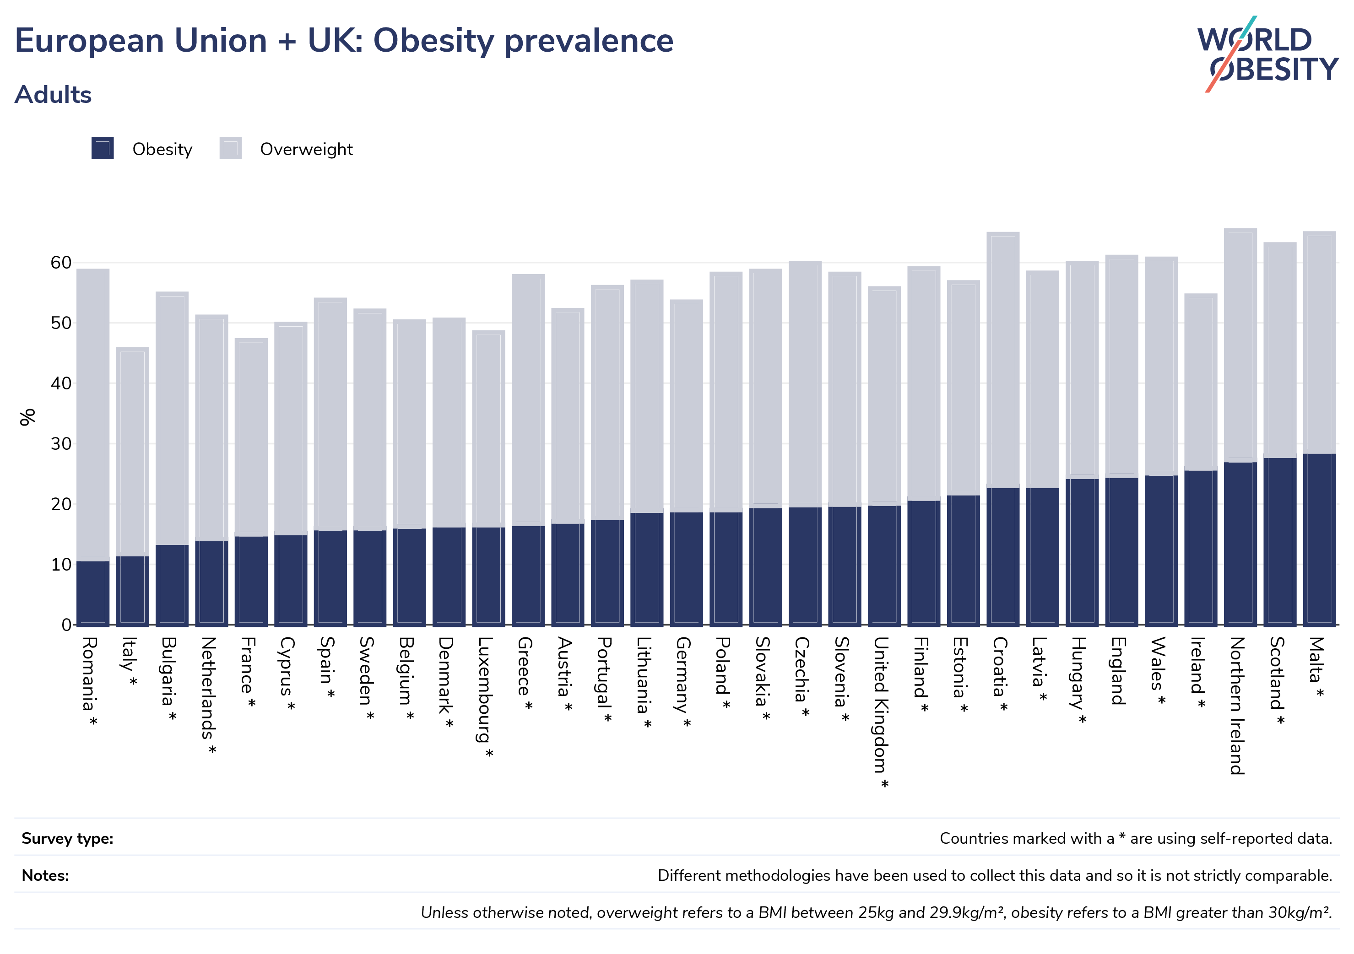

Slide 4
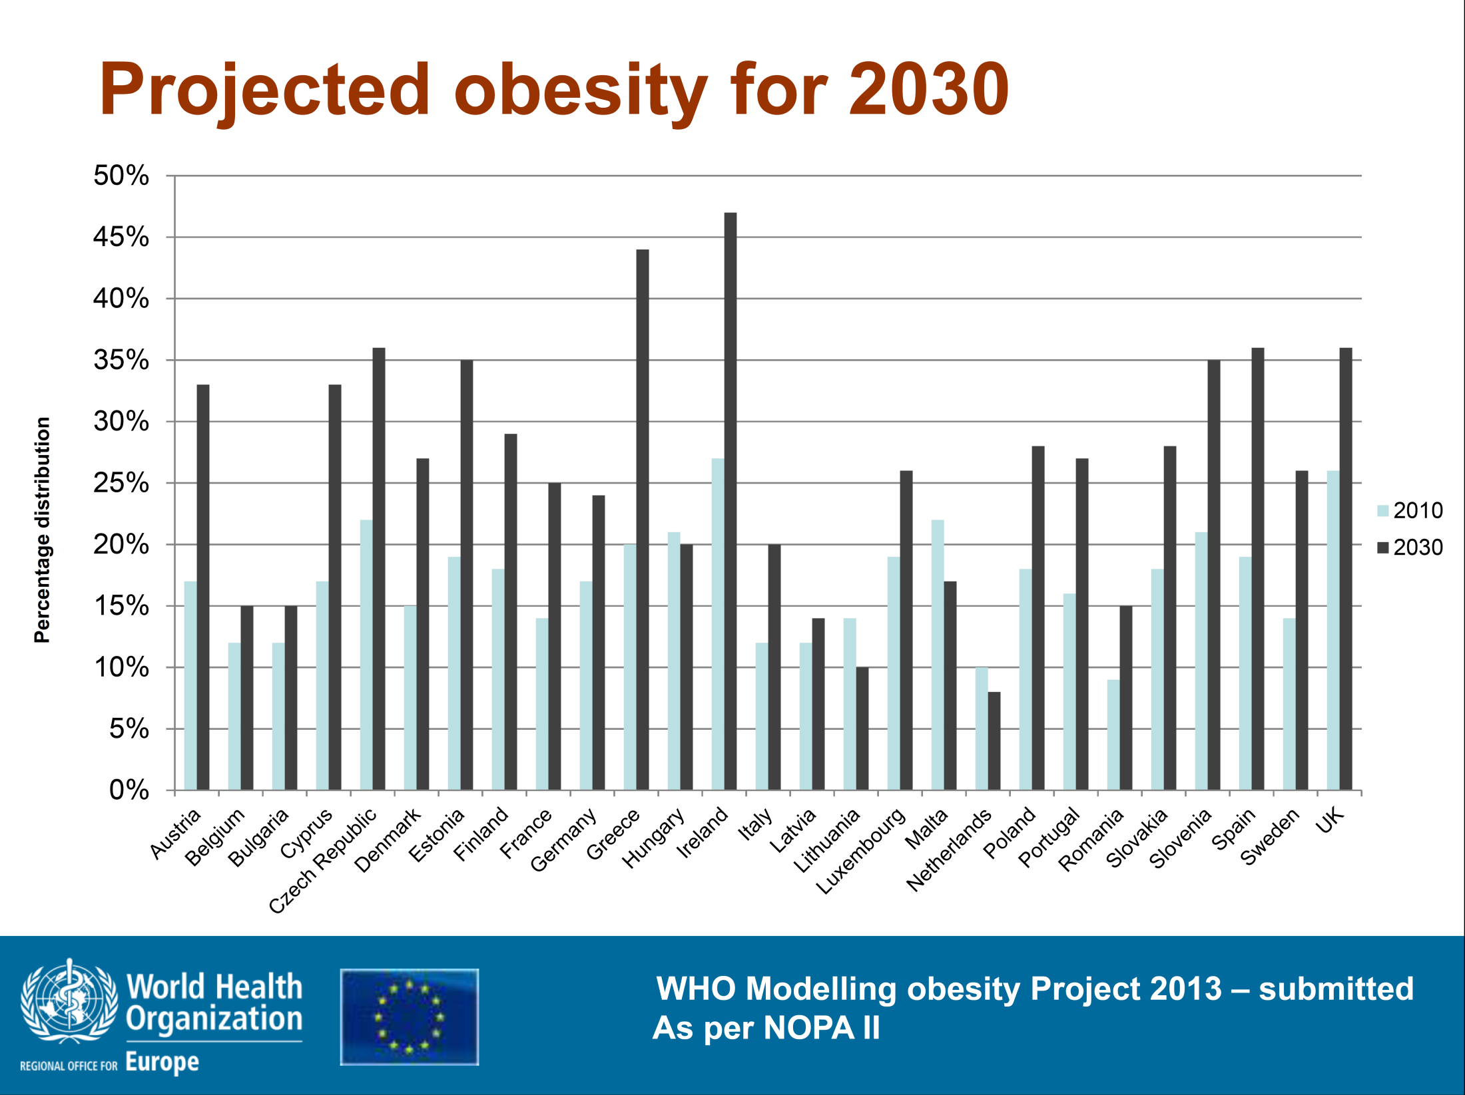

Slide 5
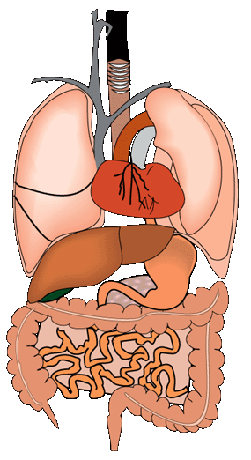
Complications of Obesity
Pulmonary disease
abnormal function
obstructive sleep apnea
hypoventilation syndrome
Stroke
Cataracts
Nonalcoholic fatty liver disease
steatosis
steatohepatitis
cirrhosis
Coronary heart disease
Diabetes
Dyslipidemia
Hypertension
Renal disease
Gall bladder disease
Cancer
Urinary incontinence
Erectile disfunction
Disability
Frailty
Osteoarthritis
Phlebitis
venous stasis
Skin
Gout

Slide 6
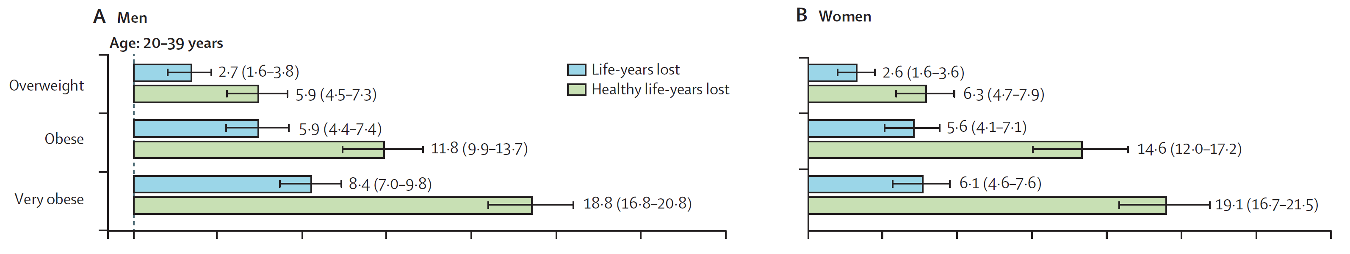
Years of life lost and healthy life-years lost in people with overweight and obesity: a modelling study
Grover et al, Lancet 2014
Women
Women

Slide 7
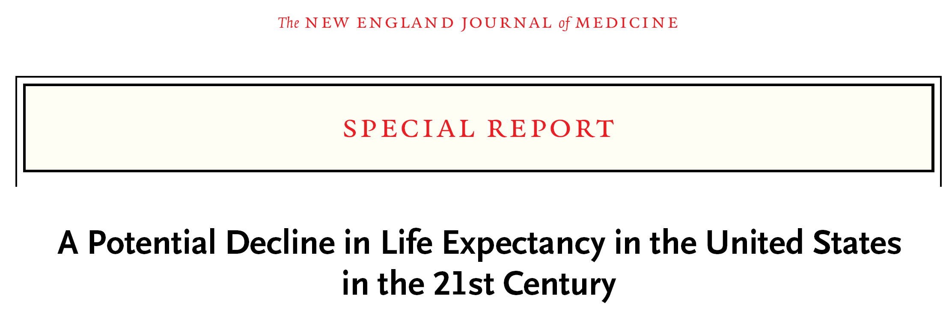
“Unless effective population-level interventions to reduce obesity are developed, the steady rise in life expectancy observed in the modern era may soon come to an end and the youth of today may, on average, live less healthy and possibly even shorter lives than their parents.”

Slide 8
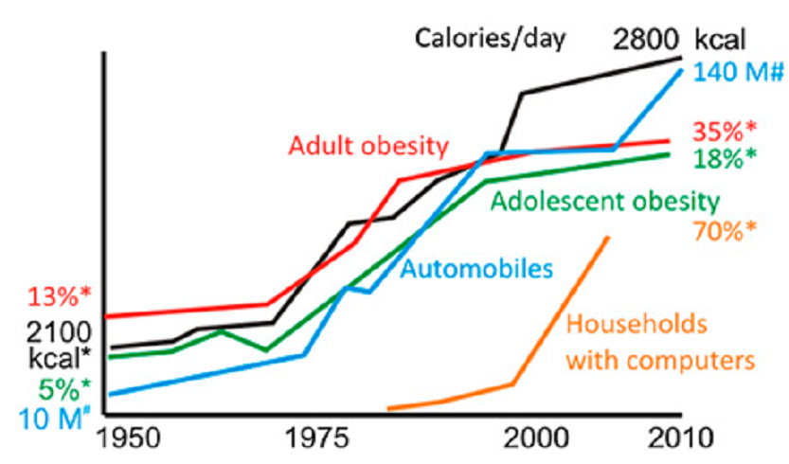
The rising tide of obesity is strongly associated with daily calorie intake and sedentary lifestyle-promoting transportation
Mattson et al., PNAS 111: 16647–16653, 2014

Slide 9
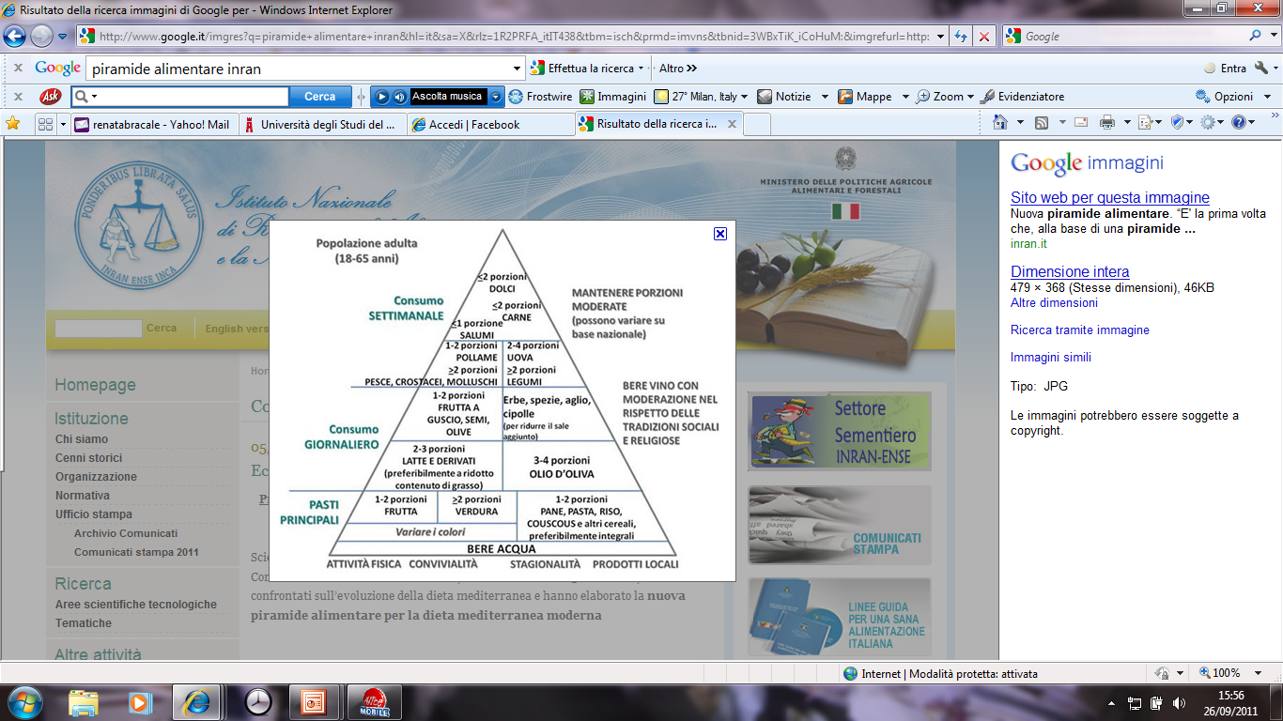
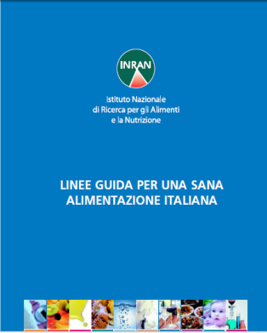


Mediterranean Diet
International guide lines for caloric assumption:
Carbohydrates: 60%
Lipids: 30%
Proteins: 10 %
Centro Studio e Ricerca sull’Obesità (C.S.R.O.)
Dipartimento di Farmacologia, Chemioterapia e Tossicologia Medica,
Università degli Studi di Milano, Via Vanvitelli 32, Milano
_{Prof. Michele Carruba}

Slide 10
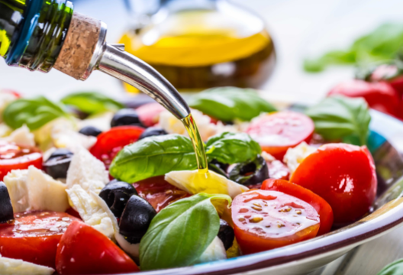
Characteristics food choices of the Mediterranean diet
⇓ Eggs and cheese
⇓ Red meat and processed meat
⇓ Animal fats
⇑ Sea food
⇑ Whole grains
⇑ Vegetables and legumes
⇑ Olive oil
⇑ Fresh fruits and nuts

Slide 11
Implementation of two of the food choices characteristic of the traditional Mediterranean diet is associated with a 20% reduction in
all-cause mortality
Sofi F et al BMJ 2008
Notes:
The health benefits of the traditional Mediterranean diet have been tested over the year in hundred of studies that consistently show that people who follow a diet resembling that model have a longer lifespan, has shown in this slide that reports a 20% lower rate of mortality in those implementing at least two of the features of the mediterranean diet. Other studies have shown that this type of diet is also associated with a lower risk of diabetes, cardiovascular disease and cancer. Even cognitive decline or chronic digestive diseases occurr less frequently in people following such a diet. This finding has been reproduced in different countries and in various ethnic group and therefore cannot be ascribed to genetics

Slide 12
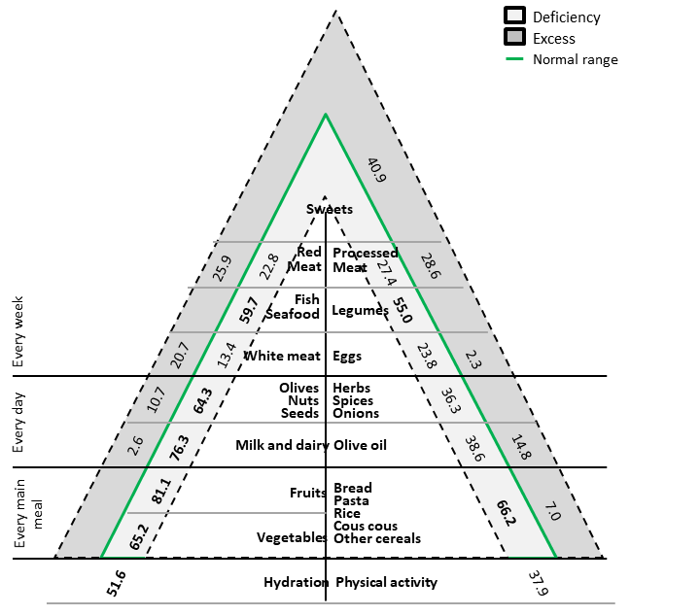
Most common deficiencies and excesses in today western diet

Slide 13
The European Commission has explicitly called for such a nutrition information system to be part of the European “strategy on nutrition, overweight and obesity-related issues” to “facilitate consumer understanding of the contribution or importance of the food to the energy and nutrient content of a diet”.
This document was endorsed by:
Italian Association of Dietetics and Clinical Nutrition (ADI) Foundation
Italian Obesity Network (IO-NET)
Italian Society for the Study of Eating Disorders (SISDCA)
Italian Society of Alimentary Sciences (SISA)
Italian Society of Paediatric Endocrinology and Diabetology (SIEDP)
Italian Association of Dietetics and Clinical Nutrition (ADI)
Italian Society of Pediatric Nutrition (SINUPE)
Italian Obesity Society (SIO)
Carruba et al., Eat Weight Disord. 2021 Oct 19

Slide 14

Nutri-Score criticisms
Nutri-Score is a supplementary nutrition labelling system of foods, developed by French researchers, based on a specific algorithm, assigning negative points to products based on their content in calories, sodium, sugar and saturated fats (per 100 g) and positive points based on their content of fibres, proteins and selected ingredients (fruit, vegetables, legumes, nuts and seeds, olive and walnut oils).
Based on the obtained final score, each food is classified into five categories: from the best (A, dark green) to the worst (E, red).
“a priori” classification of nutrients and foods as favourable and unfavourable, whereas the effect of food depends on the quantity and the frequency with which they are consumed.
highly focussed on the content of nutrients with “unfavourable” effects (up to 40 negative points), with an impact on the final score much larger than nutrients with “favourable” effects (a maximum of 15 positive points);
evaluate 100 g of a product instead of a food serving;
It does not provide helpful indicators to people with specific nutritional needs
Nutri-Score is a merely interpretative and non-educational/informative system: it does not improve the consumer’s knowledge or nutritional information. Furthermore, it does not provide any assistance in deciding the overall diet composition, nor does it facilitate in any way an appropriate combination of various foods.
No study document any favourable effect in adopting Nutri-Score on BMI at the beginning of the study
Carruba et al., Eat Weight Disord. 2021 Oct 19

Slide 15
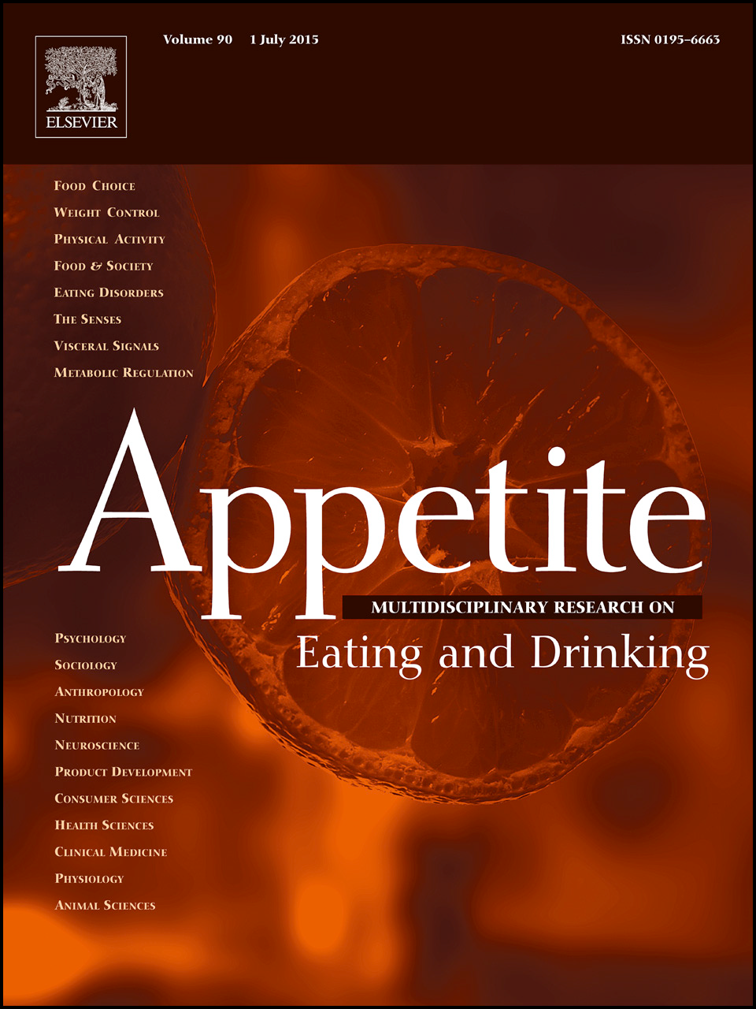
Effects of environmental impact and nutrition labelling on food purchasing: An experimental online supermarket study
Christina Potter, Rachel Pechey, Brian Cook, Paul Bateman, Cristina Stewart, Kerstin Frie, Michael Clark, Carmen Piernas, Mike Rayner, Susan A. Jebb
University of Oxford, Oxford, UK
Comparison of the environmental impact score, health score, cost, and nutrient composition of the shopping basket between trial groups
Example screenshot of labels on experimental online supermarket platform
In this study there was no evidence that the nutrition labels had any impact on the healthiness of products in the basket as measured by mean product NutriScore.

Slide 16
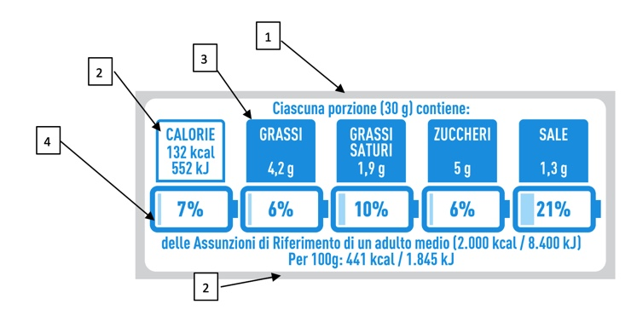
Nutrinform Battery
Informations on the serving size of the product (in g or ml).
Informations on the energy value (in kJ and kcal) per serving and per 100 g/ml.
Informations on the amount (in g) of lipids, saturated lipids, sugars and salt in one serving.
Informations on the percentage reference intake, based on the amount of each nutrient and energy value contained in a serving.

