Slide 1
Knowledge is Power: Promoting critical thinking or guiding consumers choice?
Madalina Balau, Researcher, Danubius University of Galati
Pietro Paganini, President, Competere.eu

Slide 2
Should Front-of-Pack labels stimulate easy or well-informed decision making in consumers?
The well-informed choice
The easy choice
The role of context in stimulating the choice
The link between the well-informed and easy choice
Discussing the dilemma between easy and well-informed choice in the food shopping context

Slide 3
The well-informed consumer choice
Consumers make a well-informed choice when they compare all the costs and benefits for each relevant alternative solution for their consumer problem and choose the one that maximizes their utility (have the maximum of benefits for the minimum of costs).
Advantages | Disadvantages
It ensures a ‘rational’ choice that satisfies the consumer. The consumer is aware fully aware of why one solution was chosen over the other. It is a beautiful ideal implying that the consumer has full control over his/her choices. | Consumers do not have access to perfect information about themselves or the alternatives. Usually it takes place only for expensive products with important long-term consequences Is time consuming and necessitates important cognitive efforts incompatible with the convenience approach of modern commerce

Slide 4
The easy consumer choice
Consumers adopt easy choices (fast) when a previous learning process has been taken place or when choice consequences seem unimportant for the individual. Easy choice is satisfactory in a stable context.
Advantages | Disadvantages
It takes little time Little cognitive effort is required, freeing up cognitive capacity for other individual problems Produces satisfactory choices in the short run Can be easily imitated | As soon as the context changes, easy choices become less satisfactory Easy choices based on habits are hard to change and unlearn The initial reasons that have led to the easy choice may become opaque to the consumer.

Slide 5
The role context plays on consumer choice
The context of consumer choices has two main dimensions:
The subjective context of the individual consumer.
The objective context of choice, i.e. the structure in which the choice takes place.

Slide 6
The role context plays on consumer choice
The subjective context of the individual consumer is made of the following:
Socio-demographic characteristics of the consumer
Health condition of the consumer
Level of knowledge and experience on the subject of choice
Consumer’s cultural background and lifestyle
Consumer’s self-image and identity
Consumer’s place in his/her social network (family, friends, reference groups)

Slide 7
The role context plays on consumer choice
The structure in which the choice takes place:
The shopping environment in itself (the physical characteristics of the shop)
The time available for making choices/purchases
The time of the day when purchases are made
The information offered in the shopping environment and the implicit messages sent through the information offered
The types of interactions (with people or machines) allowed by the shopping context
Etc.

Slide 8
Linking well-informed and easy choices
HABITUAL CHOICE
LEARNING
Input
Information
Well-informed Choice
Output
Level of satisfaction
Choice Easy to Replicate
LEARNING
INITIAL CHOICES

Slide 9
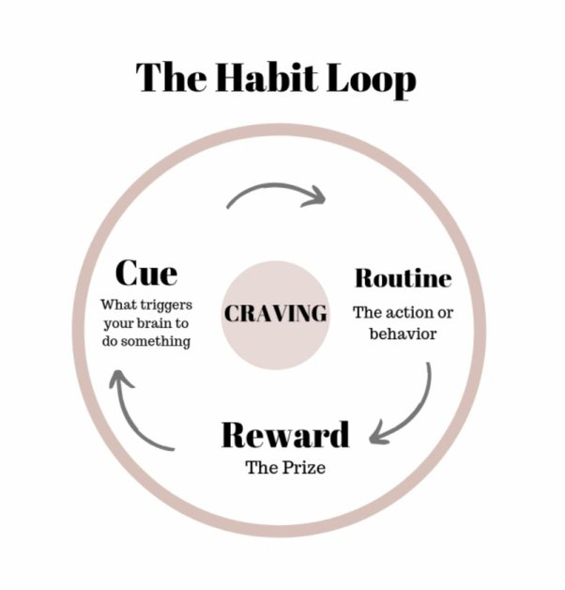
Habitual choices

Slide 10
The dilemma between easy and well-informed choice in the food shopping context
Currently the shopping context only stimulates easy choices and labels can continue to promote this idea
The high pace of changes in consumers life also promotes easy choices
The high rate of noncommunicable diseases truly makes consumers reconsider their easy food choices
Consumers should be enabled the break down the micro-decisions that have led to the easy choice, reconsider input information and make a new informed choice when needed.

