Slide 1
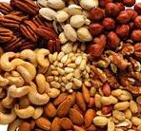
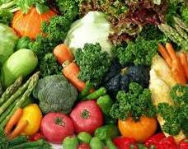
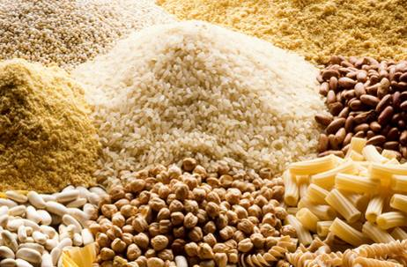
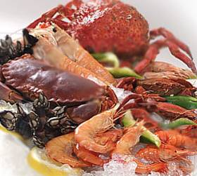
LATEST RESEARCH AND PROJECTIONS OF THE SCIENTIFIC COMMUNITY
Ramón Estruch
Department of Internal Medicine –
Hospital Clínic
University of Barcelona
CIBER OBN, Instituto de Salud Carlos III,
Government of Spain

Slide 2
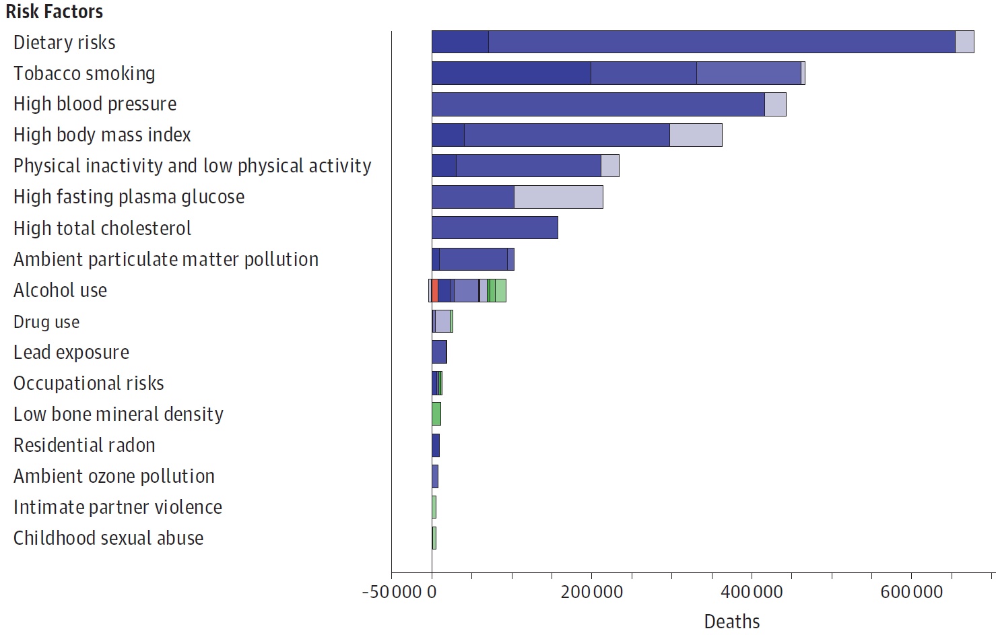
CHANGING OUR DIET
WE CAN IMPROVE OUR HEALTH
U.S. Burden of Disease Collaborators, JAMA 2016
Notes:
Instructor Note: The key point of this slide is stated in its headline:
Changing what we eat can reduce or prevent chronic diseases and lead to longer, healthier lives. Dietary factors are currently the leading cause of death from noncommunicable diseases. And if you remember the graphics we just saw above, it just so happen that foods that are better for us are also better for the environment.
You do not need to elaborate on the actual graphic, but it is here for reference. The different colors represent different types of diseases, for example diabetes, then cardiovascular diseases under dietary risks.
Relative to conventional omnivorous diets, across three alternative diets—Mediterranean, pescatarian, and vegetarian—observed in a study published in Nature, “the incidence rates of type II diabetes were reduced by 16%–41% and of cancer by 7%–13%, while relative mortality rates from coronary heart disease were 20%–26% lower and overall mortality rates for all causes combined were 0%–18% lower”
------------------------------------------------------------------------------------------------------------------------------------------------------------------------------------------------------------------------------------------
Further readings: Tilman D, Clark M. Global diets link environmental sustainability and human health. Nature. 2014;515(7528):518-522. doi:10.1038/nature13959 https://www.nature.com/articles/nature13959
https://cdn.jamanetwork.com/ama/content_public/journal/jama/936922/joi180029f2.png?Expires=2147483647&Signature=Wud8nNgHzd~SXYAipzVwz-Bq2aS7UaLsmZydQuTyUX15Um7PmXs2VXRQfSnGKKrGFGKnvsPCxV2mc27dixkfjSgK227qW1vCRMhItYdZTOFmRxk1zCsjznRyCNunNw~-nGnNA3cnatJrL40qITnirEZNcW~7~m~~g1WBV1VbMik~qJcFzX4YYQQlbrIahBXW7npRayOf6PG66f-U2JJTQQrUAnOZjG4KZEuaMJAsyipIiJ0b2AGxuy4Wt4lVjF5VqmZ8w0dkx9-oPmr08cGXU4uBF6jn3CKzGfvJnaOEMpO5tDfSB~vdEBDUao0cF2IypR2RSA7Kw1iiXB3ms9B37g__&Key-Pair-Id=APKAIE5G5CRDK6RD3PGA

Slide 3
NUTRITIONAL INTERVENTION
PERSONALIZED NUTRITION
POPULATION NUTRITION
PLANETARY NUTRITION

Slide 4
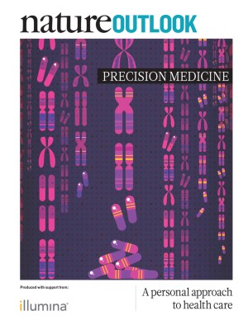
Stratified nutrition
  A tailored nutritional approach that groups together individuals with shared characteristics in order to create advice and solutions suited to each group.
Personalized nutrition
  Every person responds differently to he same food.
Precision nutrition
  - More targeted effective diet based on individual’s personal characteristics and scientific evidences. More ambitiuos.

Slide 5
PERSONALIZED NUTRITION
DIETARY TREATMENT OF PEOPLE WITH SPECIFIC DISEASES AND THOSE THAT THEY NEED SPECIAL NUTRITIONAL ATTENTION
Inborn errors of metabolism
Food allergies and intolerances
Metabolic diseases
Life Stages: Age, Pregnancy, Lactation, …
Ethnic, cultural and religious factors
DEVELOPMENT OF EFFECTIVE PERSONALIZED
INTERVENTIONS TO IMPROVE PUBLIC HEALTH

Slide 6
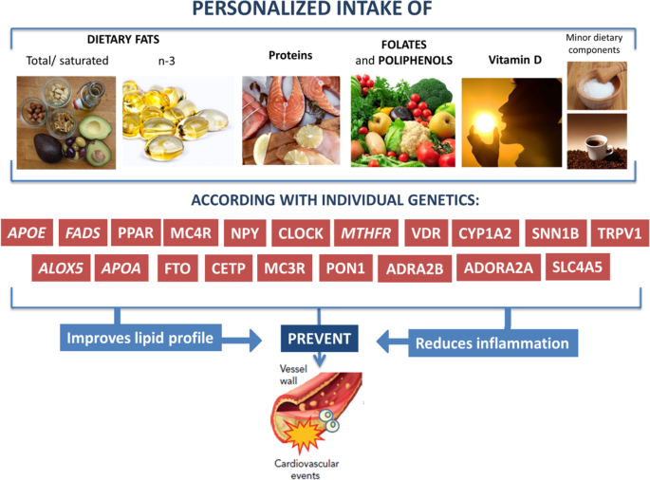
NUTRIGENETICS – PERSONALIZED NUTRITION IN OBESITY AND CARDIOVASCULAR DISEASES
International Journal of Obesity Supplements 2020;10:1–13

Slide 7
Personalized Recommendations based on Medical Record, Preferences and Genetic Data
SLC30A8: Carriers of Allel A in the rs 1158471SLC308
TCF7L2: Carriers of Allel in the rs TCF7L2 -rs7903146
MTHFR: Carriers of the Genotype TT in the MTHRC677T
Supplements of Zn to maintain glucose homeostasis (8 mg/d)
Mediterranean diet reduces stroke risk.
Vitamin B2 (riboflavin) supplements reduce risk of Hypertension

Slide 8

RANDOMIZED CLINICAL TRIAL TO STUDY THE EFFICACY OF PERSONALIZED NUTRITION
1607 participants from 7 European countries.
Random distribution into 4 groups (0,1,2 and 3) – L0 (control), L1 (Dietary Data-DD), L2 (DD + Phenotypic Data-DF) and L3 (DD + DF + Genotypic Data).
Internet intervention. Follow-up 6 months.
Conclusion: Personalized nutrition is more effective than the conventional intervention “one-size-fits-all”

Slide 9
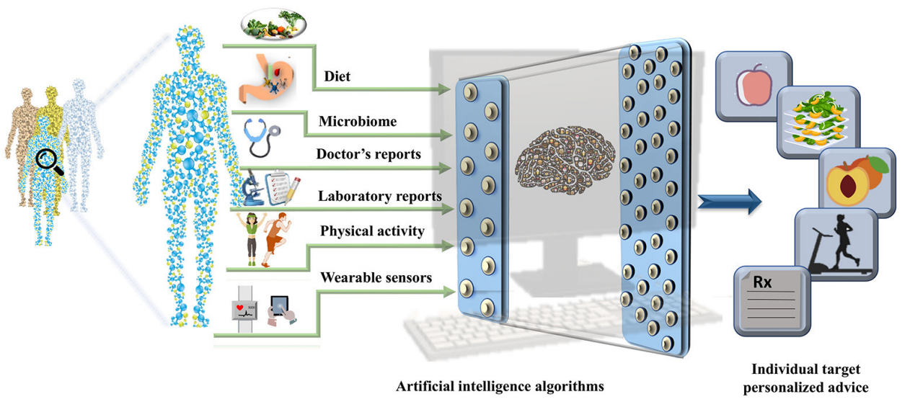
CHALLENGES IN PERSONALIZED NUTRITION AND HEALTH
Verma M et al. Front Nutr. 2018

Slide 10
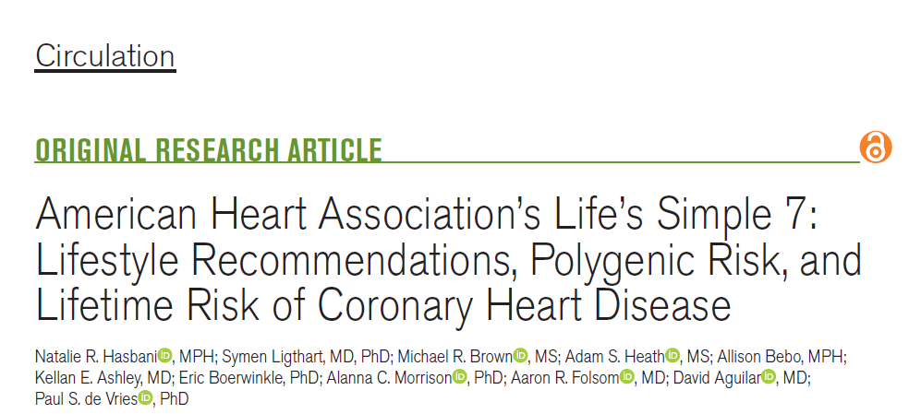
Hasbani NR, et al. Circulation. 2022.

Slide 11
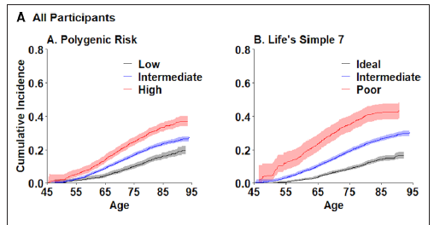
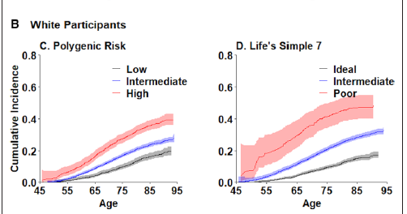
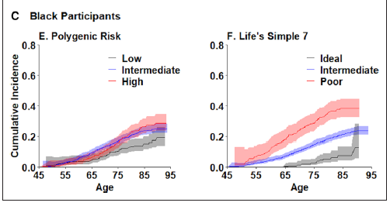
Figure 1. Cumulative incidence of CHD according to polygenic risk and Life’s Simple 7 score
The polygenic risk score (PRS) comprised
more than 6 million genetic variants
categorized into low (<20th percentile),
intermediate, and high (>80th percentile)
Hasbani NR, et al. Circulation. 2022.

Slide 12
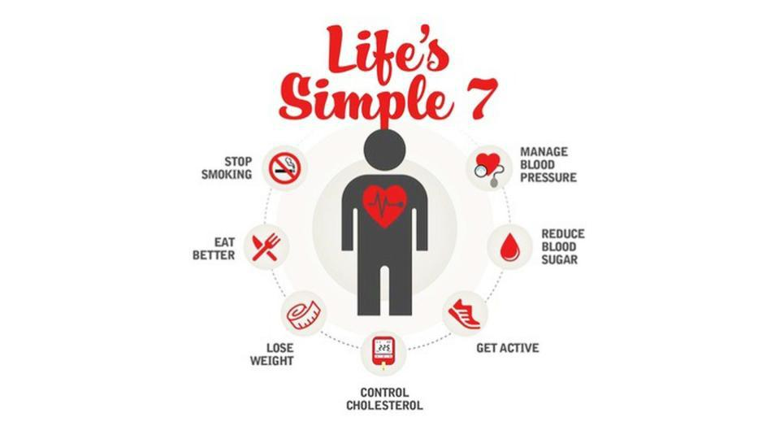

Slide 13
NUTRITIONAL INTERVENTION
PERSONALIZED NUTRITION
POPULATION NUTRITION
PLANETARY NUTRITION

Slide 14


THE MEDITERRANEAN DIET
THE BEST DIETARY PATTERN IN 2022
MEDITERRANEAN DIET
DASH DIET
FLEXITARIAN DIET

Slide 15
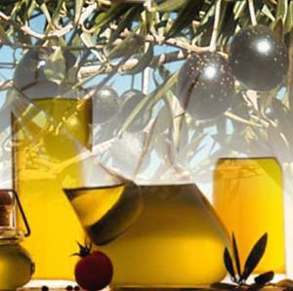
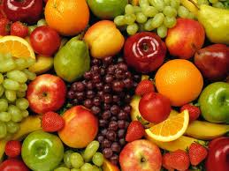
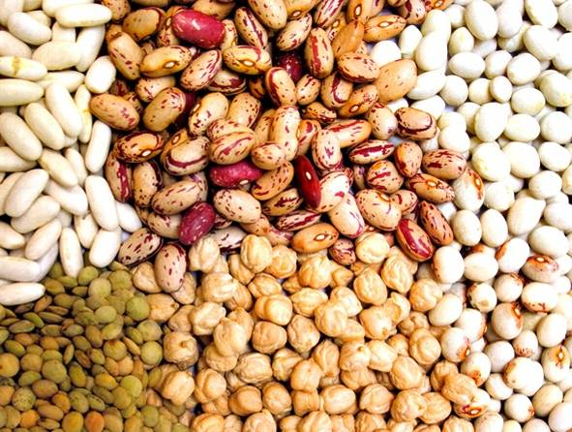
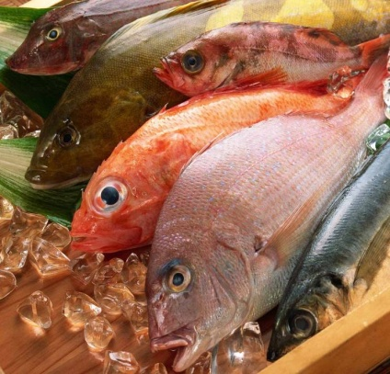
Effects of the Mediterranean Diet on Primary Prevention of Cardiovascular Disease
(PREDIMED study)

Slide 16
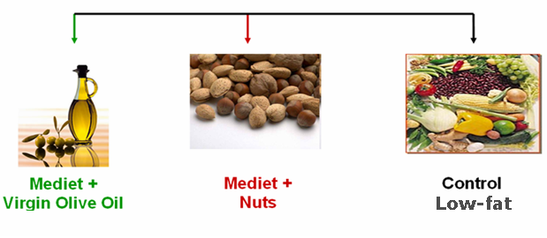
PREDIMED TRIAL: DESIGN
Men: 55-80 yr
Women: 60-80 yr
High CV risk without CVD
  type 2 diabetics
  3+ risk factors
Smoking
Hypertension
↑ LDL
↓ HDL
Overweight/obese
Family history
All free of CVD at baseline
Random
Estruch R, et al. N Engl J Med. 2018

Slide 17
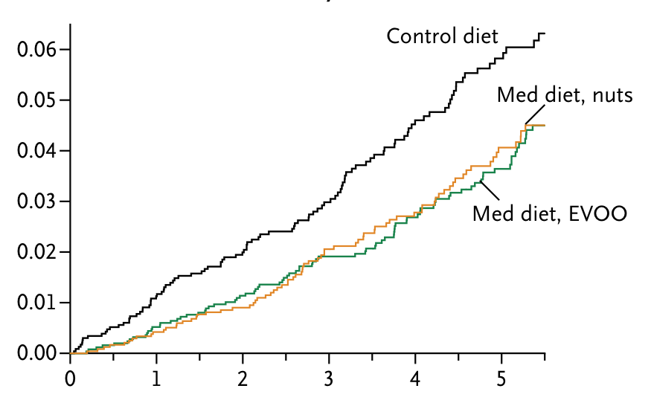
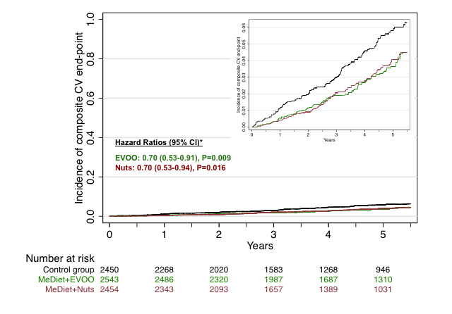
Estruch R, et al. N Engl J Med. 2018

Slide 18
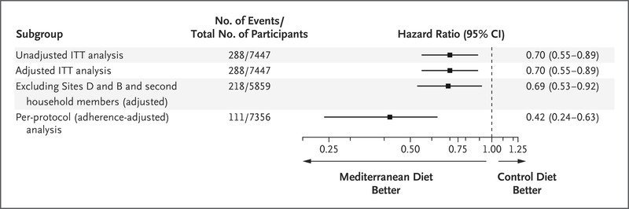
Sensitivity Analyses of Combined Mediterranean Diet Groups and
the Control Group
Estruch R, et al. N Engl J Med. 2018

Slide 19
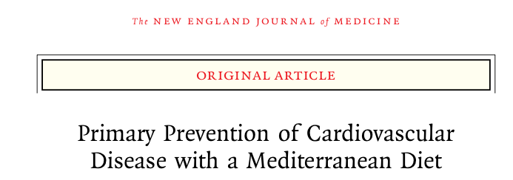
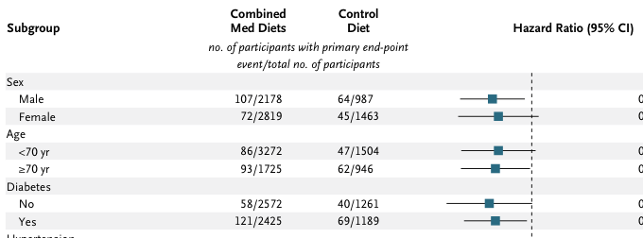
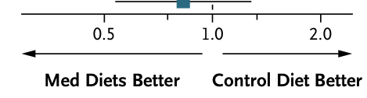

Slide 20
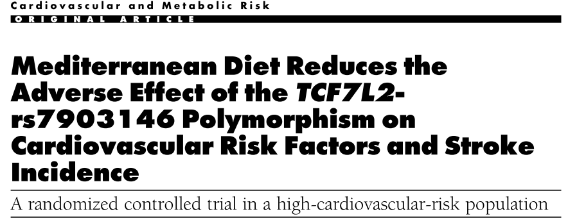
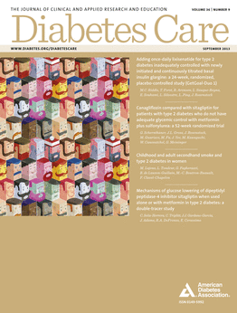
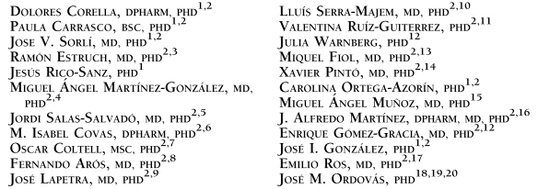
2013

Slide 21
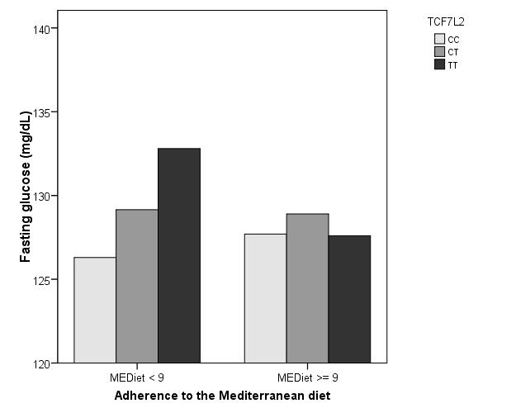
Interaction between TCF7L2 polymorphism and adherence
to the Mediterranean Diet
on plasmatic concentrations of glucose
A
P-interaction TCF7L2 x AdMEDiet: 0.014
P=0.001
P=0.281

Slide 22
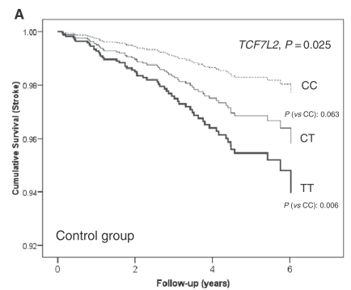
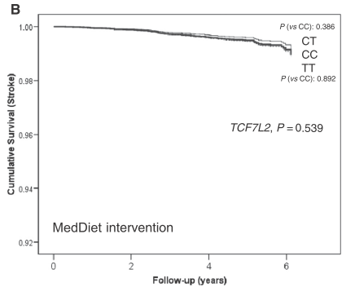
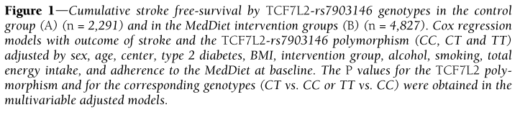
Interaction between TCF7L2 polymorphism and adherence
to the Mediterranean Diet on Risk of Stroke

Slide 23
NUTRITIONAL INTERVENTION
PERSONALIZED NUTRITION
POPULATION NUTRITION
PLANETARY NUTRITION

Slide 24
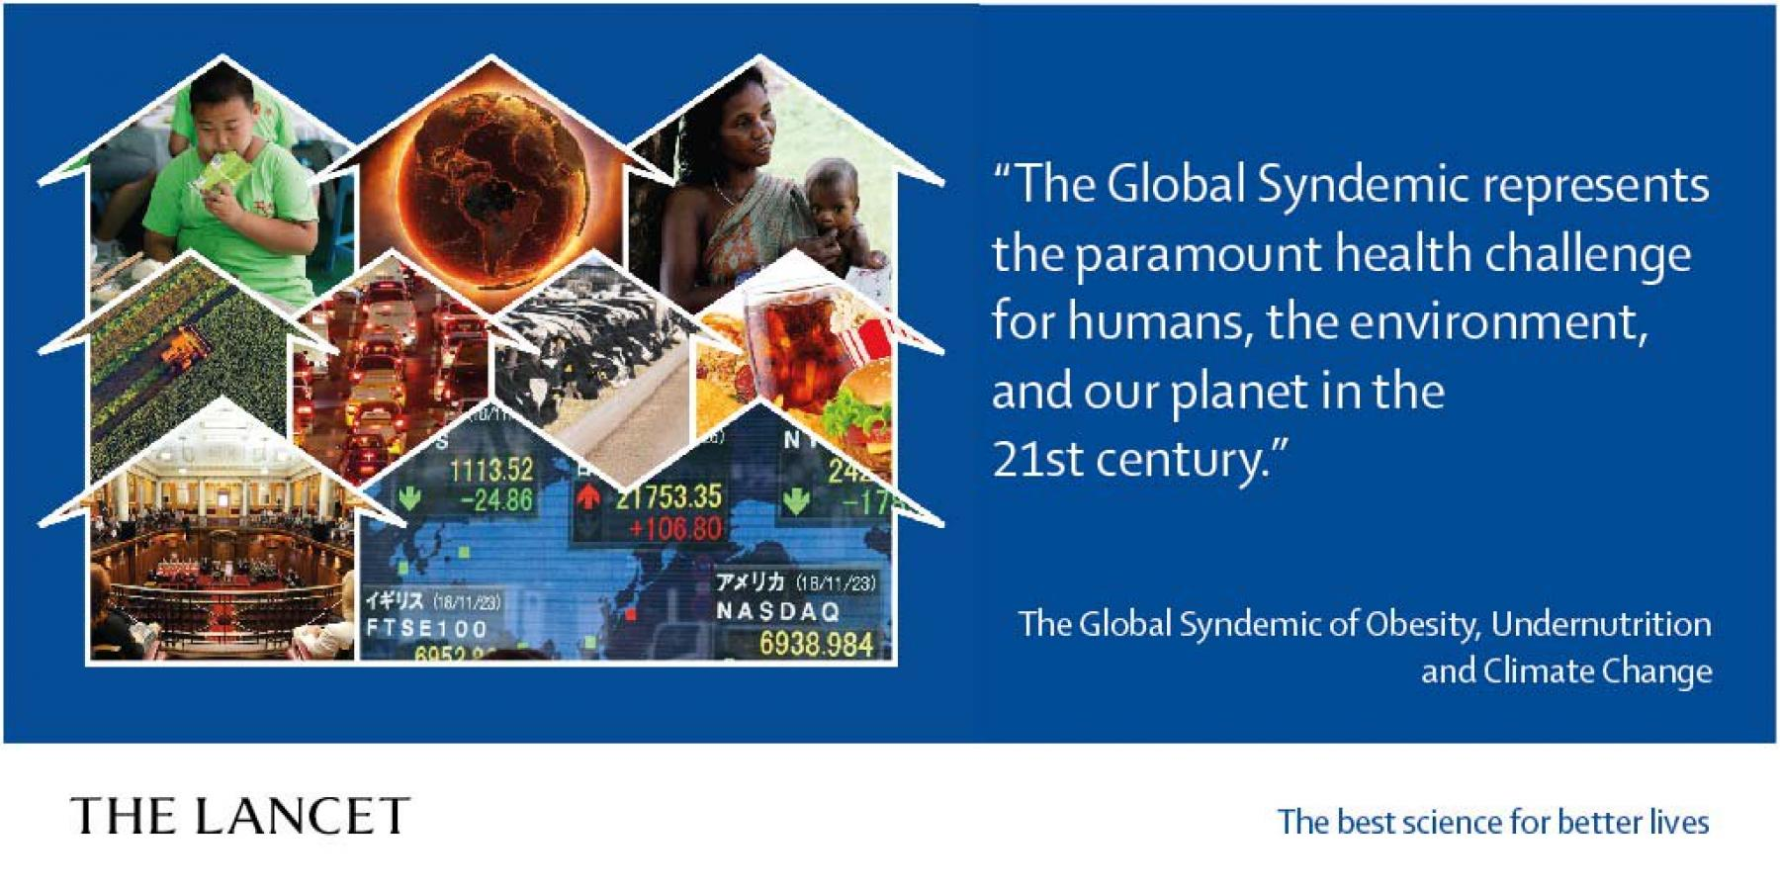
GLOBAL SYNDEMIC OF OBESITY, UNDERNUTRITION AND CLIMATE CHANGE

Slide 25
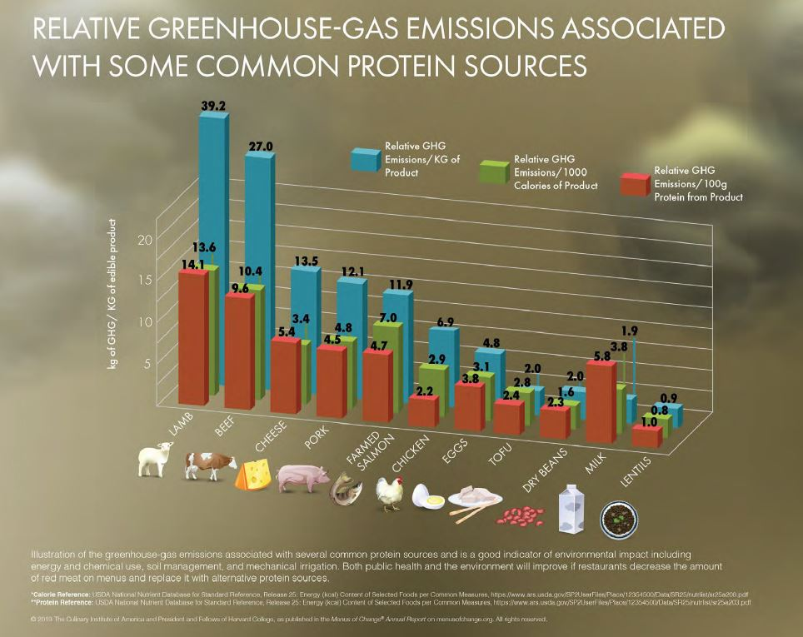
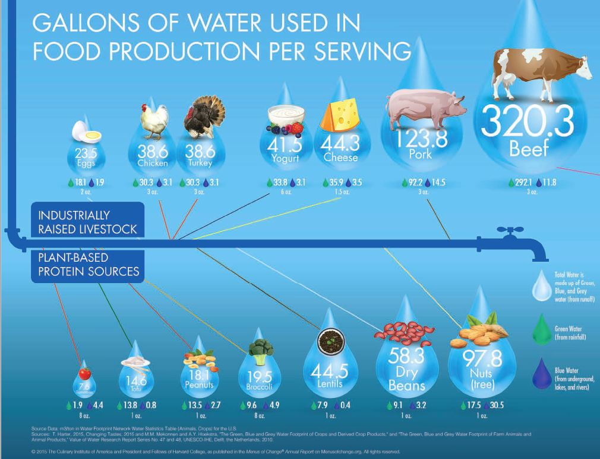
THE PRODUCTION OF RED MEAT HAS A NEGATIVE IMPACT ON THE ENVIRONMENT
Notes:
Instructor Note: Point out some of the differences in amount of greenhouse-gas emissions (since they will be quizzed on it later), for example the animal proteins to the left of the graph and the dry beans and lentils on the right.
As we’ve seen in the Animal Husbandry and Water modules, different foods have different water requirements, and/or are cultivated differently around the world, with varying environmental impacts as a result.
The production of red meat has a greater environmental impact, from greenhouse gas emissions to water usage, than most produce. Traditional methods of almond production, as historically practiced in the Mediterranean, do not require a lot of water, but more recent, large scale production, for example in California, has been achieved by flooding fields rather than drip irrigation by each individual trees. Producers in such areas, faced with criticism of these methods in light of their environmental impacts as well as years of drought, are working to change them for more sustainable growing practices.
As you can see form these graphics, plant-based proteins have a much lower environmental impact than animal proteins. As such, focusing menus on a greater range of plant-based foods will have a positive impact on the sustainability of the planet. This does not mean that animal products need to disappear from your menus, but rather that it becomes more important than ever to focus on high-quality animal proteins, raised ethically, and decrease the typical reliance on meat on our menus.
-------------------------------------------------------------------------------------------------------------------------------------------------------------------------------------------------
Additional Readings:
https://www.menusofchange.org/images/uploads/pdf/Protein_Plays_lowres.pdf

Slide 26
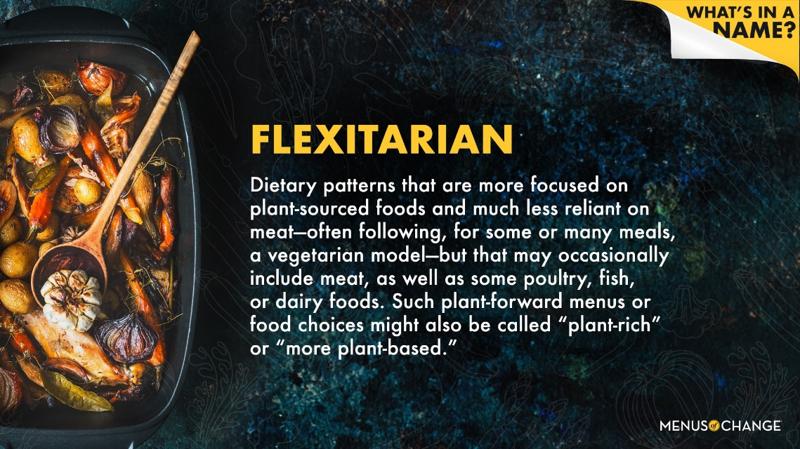
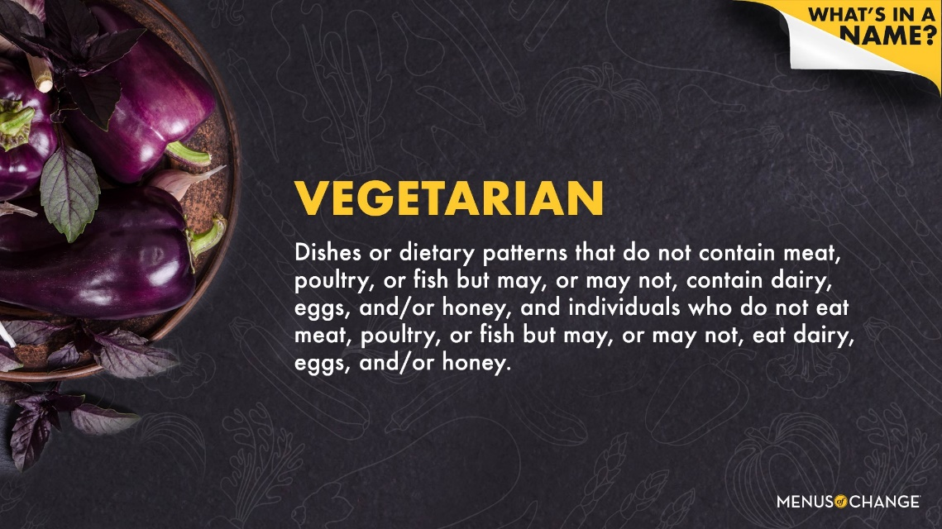
PLANT- BASED AND PLANT-FORWARD DIETS

Slide 27
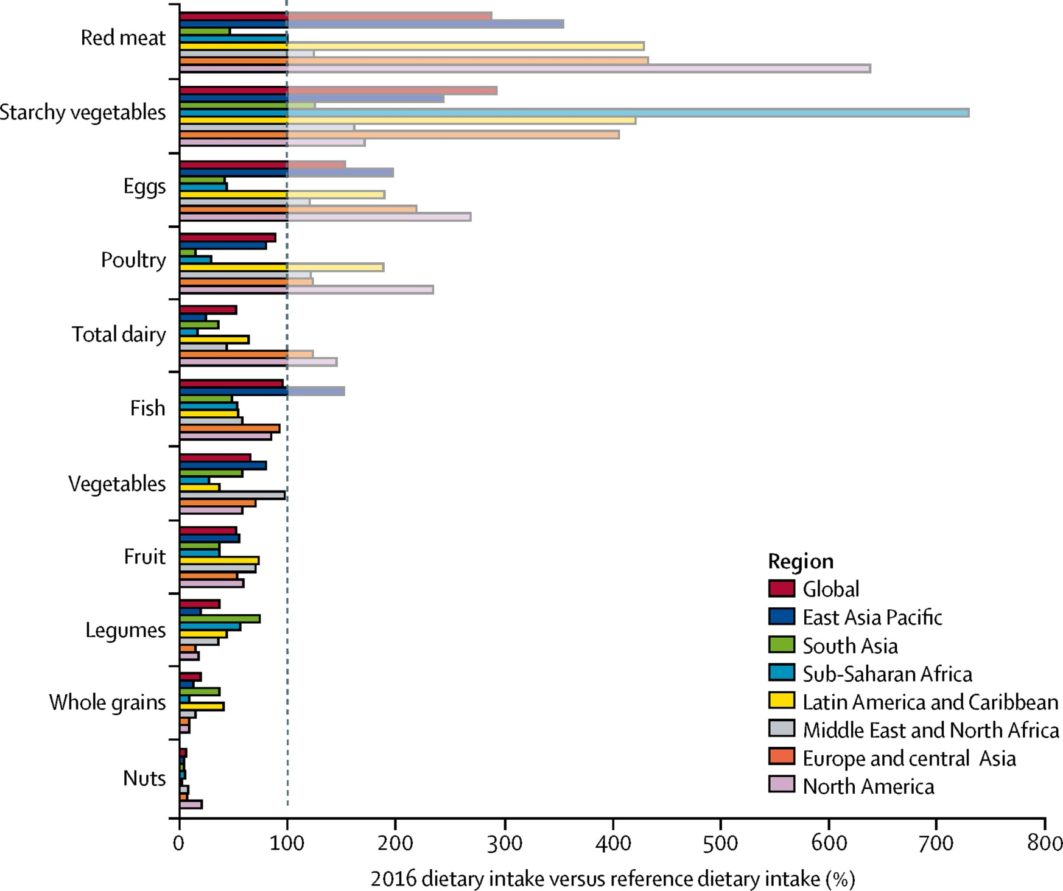
DIETARY PATTERNS IN 2016 & REF. DIET INTAKES
Lancet 2019;393,447

Slide 28
CONCLUSIONS
Personalized nutrition tailored to individual characteristics and behaviors is very promising, but further studies are needed before it can be widely implemented.
The Mediterranean Diet is the best population nutrition strategy to prevent cardiovascular disease, diabetes, neurodegenerative diseases and cancer.
To preserve the health of the planet, we should take into account both the quality of population nutrition and the environmental impact of the food grown or raised.
The best personalized nutrition is often the best population nutrition and also the best nutrition for the planet.

Slide 29
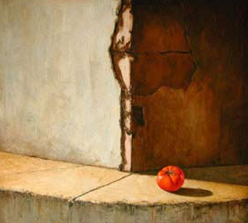
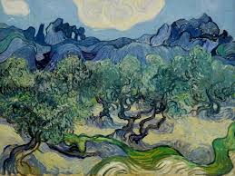
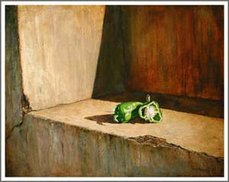

Email: restruch@clinic.ub.es
Twitter: @restruch_MD
THE OLIVES – Vicent van GOGH - MOMA – NEW YORK
THANK YOU FOR YOUR ATTENTION

